Slide 1





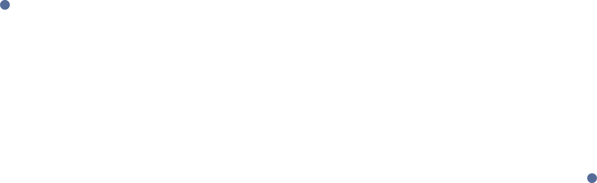
Your Voice Matters. Don’t Let AI Drown It Out
Checkpoint 2
Ângela Ribeiro (109061)
João Santos (110555)
João Viegas (113144)
Hugo Castro (113889)
Ana Rita Silva (114220)
Advisors:
Prof. João Rafael Almeida
Vicente Barros
Notes:
ugo
2ª Milestone
Elaboration Phase
BotBlocker

Slide 2

PROJECT OVERVIEW
BotBlocker is a browser extension and website that uses community intelligence to identify and block automated social media profiles.
2

Slide 3

TABLE OF CONTENTS
01
Introduction
02
Previously Implemented Functionalities
03
Newly Implemented Functionalities
04
Project Calendar
3
Notes:
ugo

Slide 4
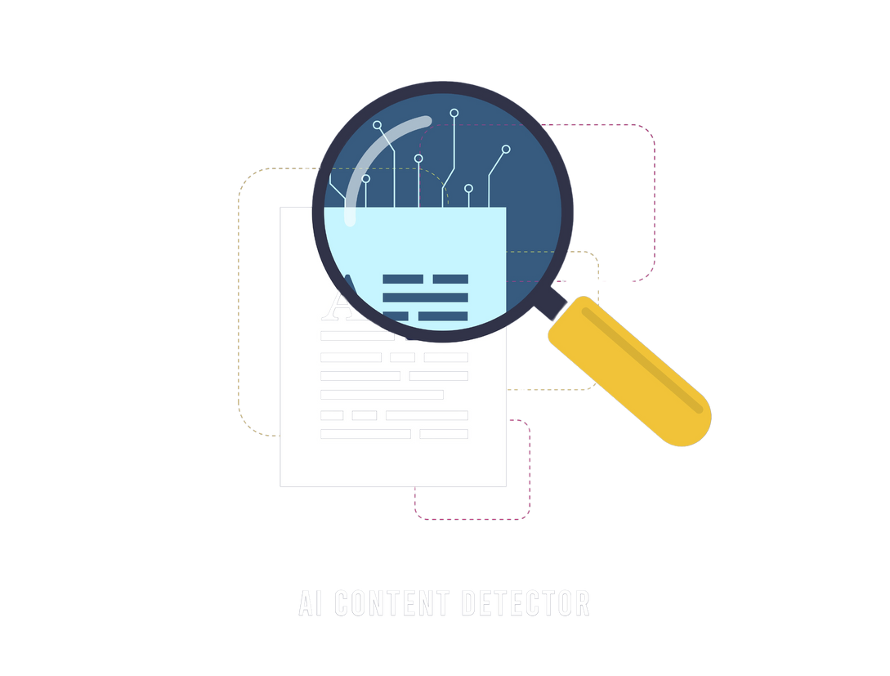
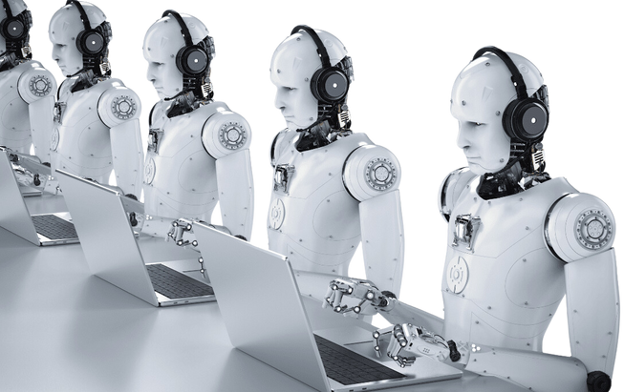

INTRODUCTION
Detection and Blocking
AI Bots
Website + Extension
Manipulating engagement and spreading misinformation.
Detect and block interactions with AI profiles.
Identifying AI-driven accounts for transparency.
4
Notes:
presença de bots nas redes sociais
website+extensão
detectar e bloquear
eficaz, fácil

Slide 5
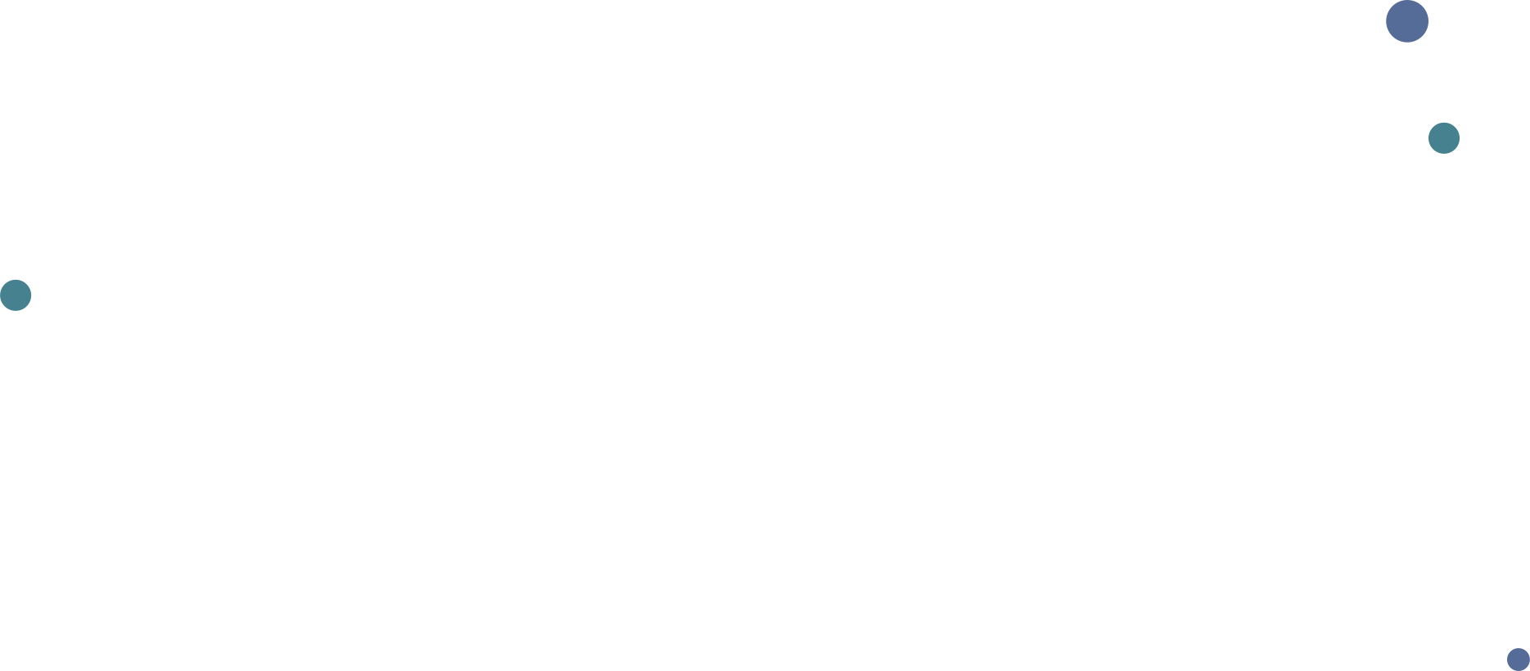
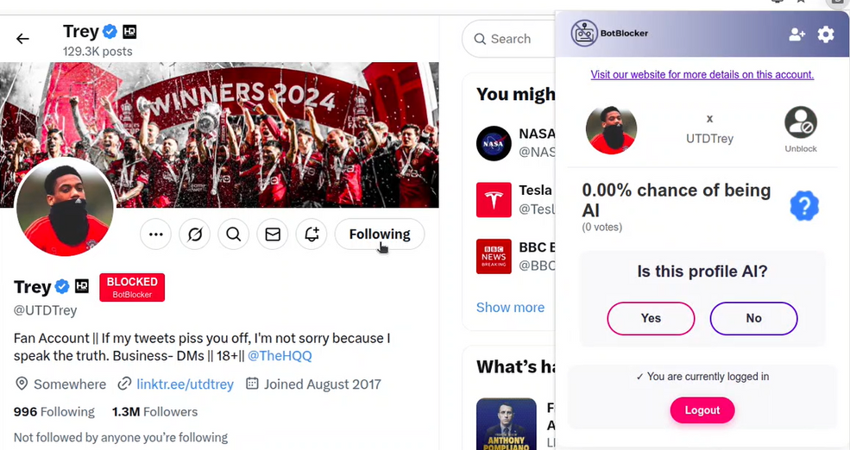
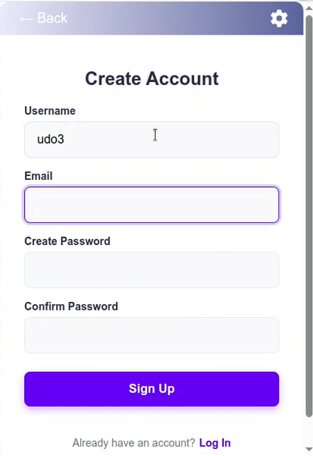
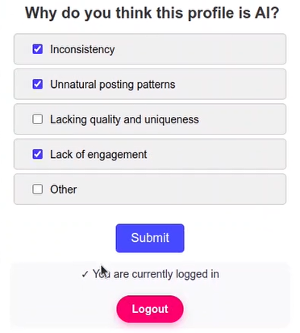

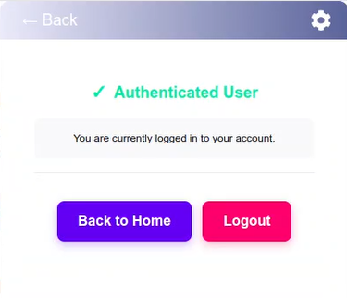
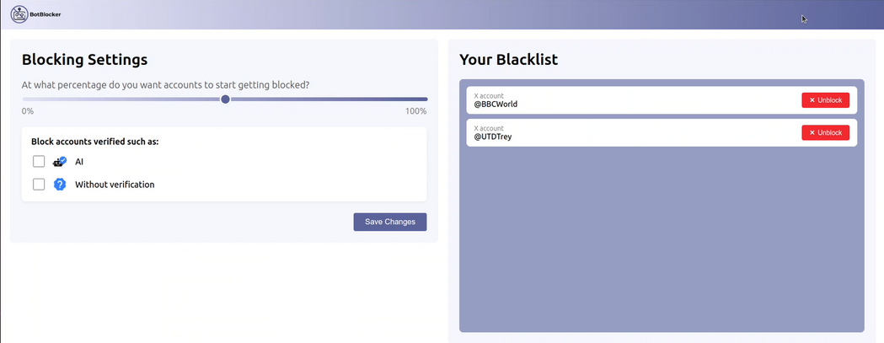
PREVIOUSLY IMPLEMENTED FUNCTIONALITIES
5
Notes:
ugo
administrador e verifier
1. alterar roles, suspender contas ou banir utilizadores
2. logs de atividades suspeitas (spam voting)
3. moderar avaliações feitas pela comunidade
4. selos de "Bot" ou "Humano" (transparência)

Slide 6
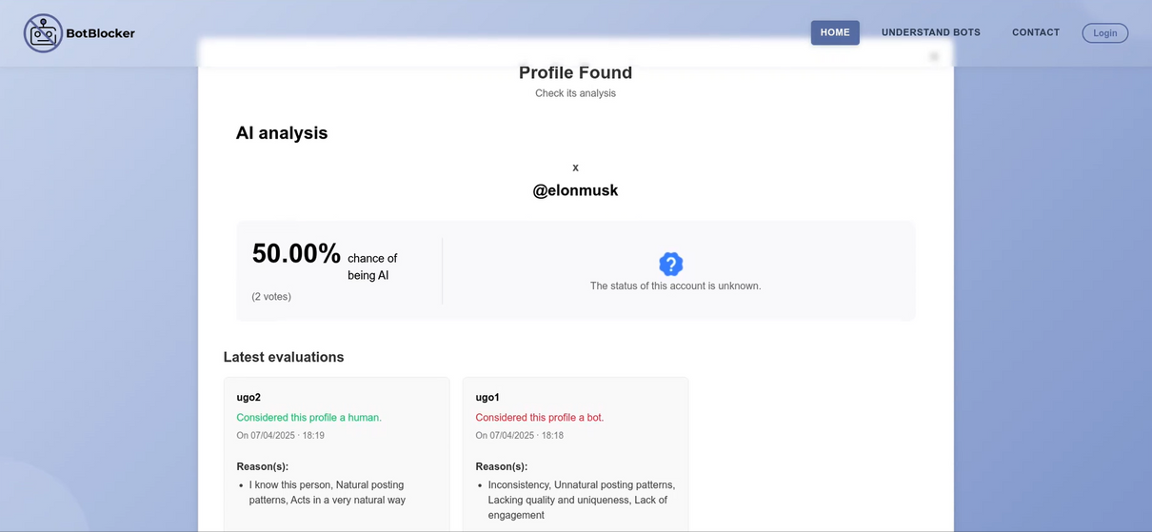
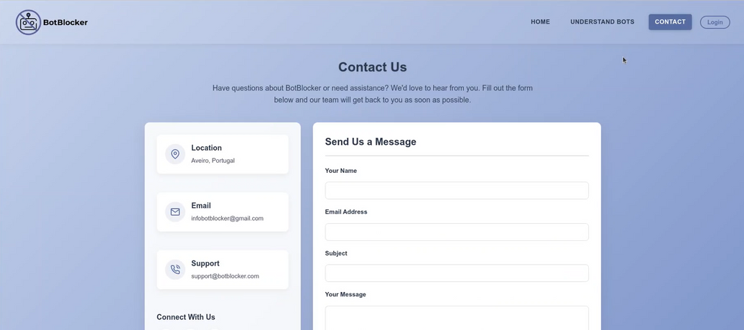
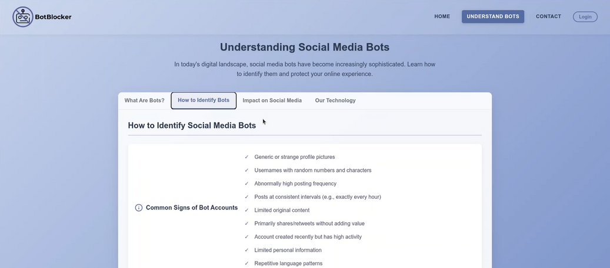
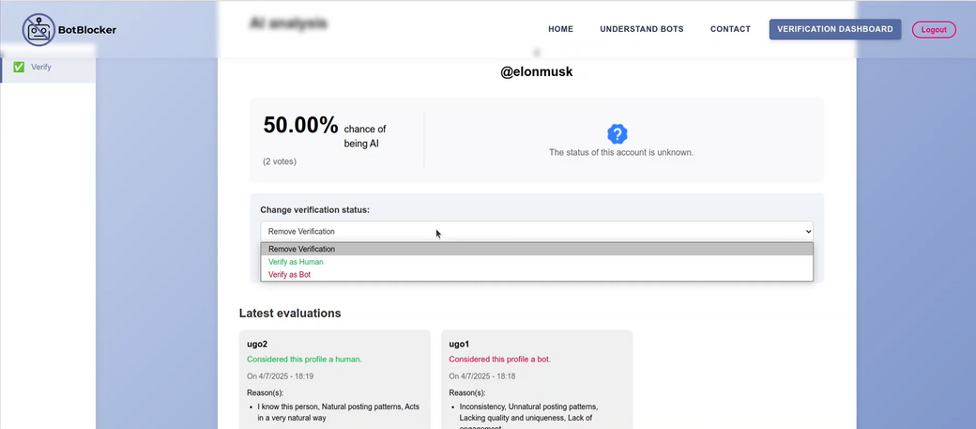
PREVIOUSLY IMPLEMENTED FUNCTIONALITIES
6
Notes:
ugo
administrador e verifier
1. alterar roles, suspender contas ou banir utilizadores
2. logs de atividades suspeitas (spam voting)
3. moderar avaliações feitas pela comunidade
4. selos de "Bot" ou "Humano" (transparência)

Slide 7
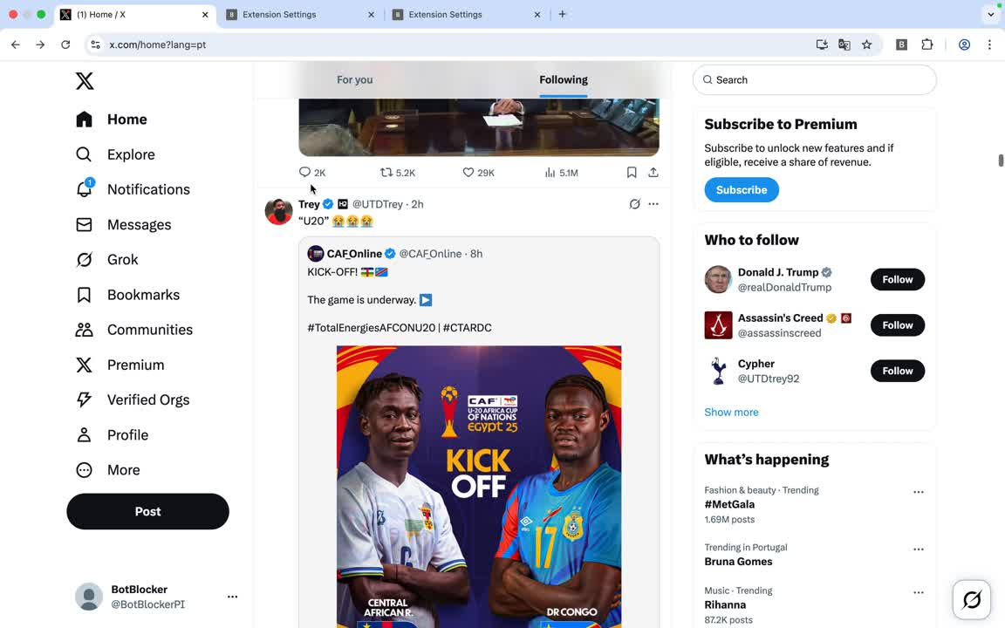
NEWLY IMPLEMENTED FUNCTIONALITIES
Video demo - Blocked accounts on your timeline
7
Notes:
ugo
administrador e verifier
1. alterar roles, suspender contas ou banir utilizadores
2. logs de atividades suspeitas (spam voting)
3. moderar avaliações feitas pela comunidade
4. selos de "Bot" ou "Humano" (transparência)

Slide 8
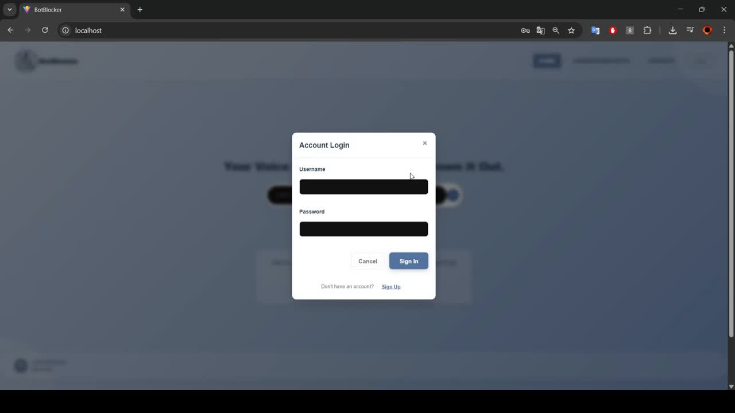
NEWLY IMPLEMENTED FUNCTIONALITIES
Video demo - New Admin Features
8
Notes:
ugo
administrador e verifier
1. alterar roles, suspender contas ou banir utilizadores
2. logs de atividades suspeitas (spam voting)
3. moderar avaliações feitas pela comunidade
4. selos de "Bot" ou "Humano" (transparência)

Slide 9
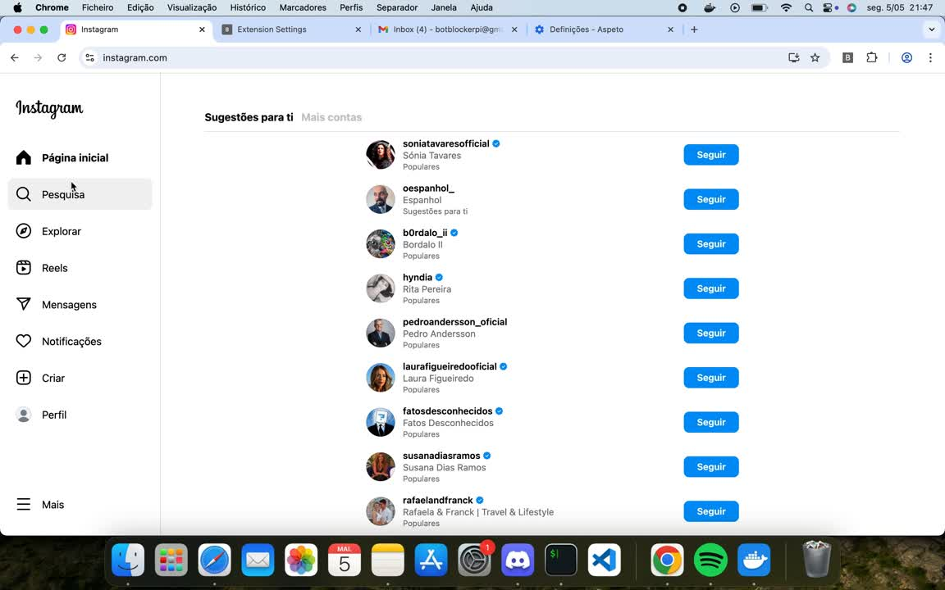
NEWLY IMPLEMENTED FUNCTIONALITIES
Video demo - Instagram Transition
9
Notes:
ugo
administrador e verifier
1. alterar roles, suspender contas ou banir utilizadores
2. logs de atividades suspeitas (spam voting)
3. moderar avaliações feitas pela comunidade
4. selos de "Bot" ou "Humano" (transparência)

Slide 10

PROJECT CALENDAR
10/02 - 17/02
18/02 - 24/02
25/02 - 03/03
04/03 – 10/03
Project Foundation & Documentation Setup
Use Case Diagram (JC, JV, Â)
GitHub Repository Organization (H)
Setup Documentation Website (AR, H)
Project Planning and Framework
Project Calendar Creation (*)
Jira Project Setup (Â)
Project Presentation Preparation (*)
Definition of Context and State of the Art (JV)
High-Level Architecture Design (JC)
Requirements & UX Design
Requirement Gathering (*)
Functional Requirements (JV)
Non-Functional Requirements (Â)
Define Personas and Scenarios (JC)
Develop the mockups (AR, H)
System Modeling
Refine the state of the art (JV)
Technological Model (*)
Define the Domain Model (JC)
Make the Deployment Diagram (JC)
Presentation (*)
11/03 – 17/03
18/03 – 24/03
25/03 – 31/03
Extension Initiation and Database Setup
Dockerize the project (H)
Database Configuration and Setup (Â, JC)
Extension Initialization and Configuration (Â, JC)
Development of Extension Popup Frontend (AR)
Backend API Implementation for Popup Interaction (JV)
Interface Development & API Integration
Development of the extension interface and the user website (JC, H)
Develop the frontend for the verifier interfaces (AR)
Continue Implementation of RESTful API (JV, Â)
Blocking & Filtering System Development
Develop the block system (JC, H, JV)
Develop the filtering / blacklist management (AR, Â)
10
Notes:
ângela

Slide 11
PROJECT CALENDAR
01/04 – 07/04
08/04 – 14/04
15/04 – 21/04
22/04 – 05/05
Presentation and refinement
Presentation (*)
Continue developing the block and blacklist management system
Finalize the block and blacklist management
Admin Interface & API Enhancement
Develop the frontend of the admin interface
Continue Implementation of RESTful API
06/05 – 19/05
20/05 – 26/05
27/05 – 02/06
Improving upon the filtering techniques
Demo + poster for students@deti & video
Poster
Video
Demo
Finish technical report (*)
Final presentation
Work on presentation (*)
11
Notes:
ângela

Slide 12
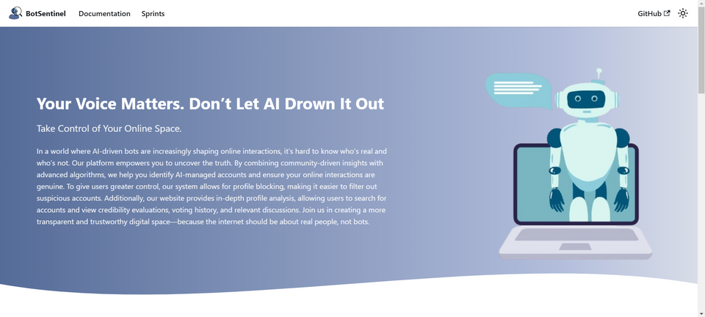

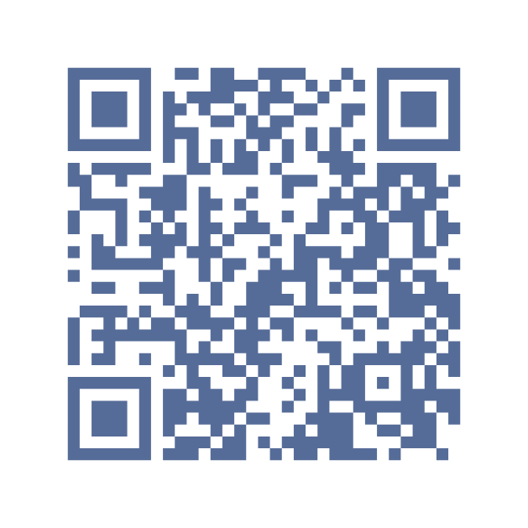
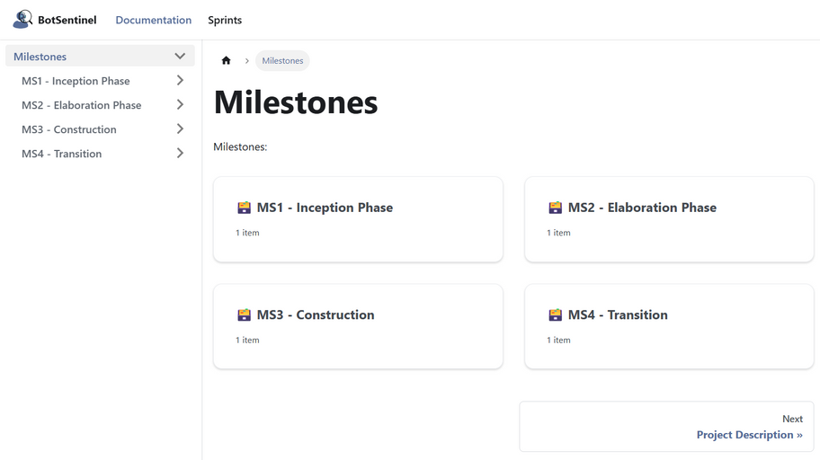
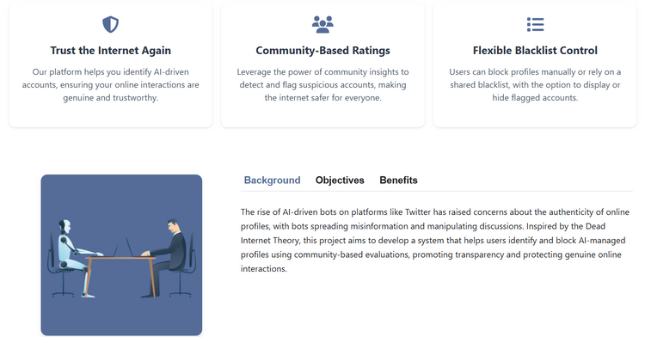
Thank you!
https://botblocker-pi.github.io/Documentation/
12
Notes:
ângela

